Slide 1
Neural Networks

Slide 2
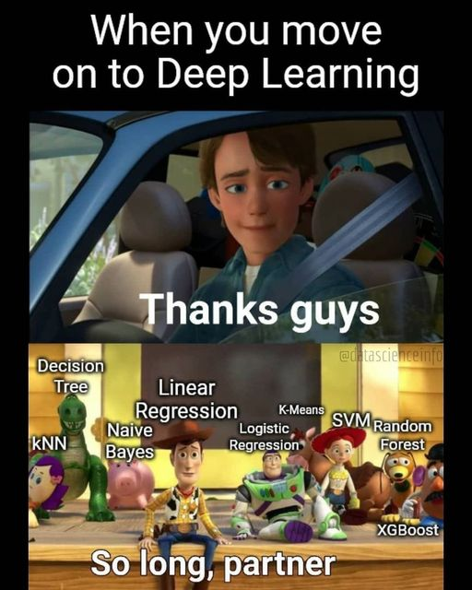
https://www.facebook.com/aimmediahouse/posts/tgisundaymoving-on-to-deeplearningmemes-memesdaily-memeoftheday-funartificialint/3413677738655320/

Slide 3
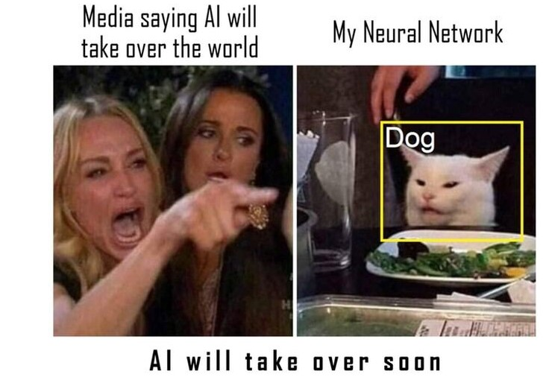
Neural Networks
In this day and age, neural networks form the basis of the vast, enormous, and overwhelming majority of the discussion around AI
ChatGPT is a Neural Network
Midjourney is a Neural Network
The neural network family is a big one but they share a lot of the same underlying characteristics
We are going to start simple
https://techvangart.com/2023/04/06/ai-trends-the-greens-the-scams-and-talent-hunt/

Slide 4
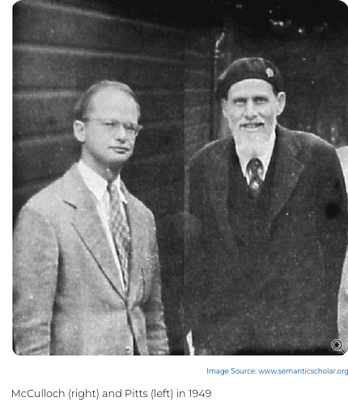
History of Neural Networks
Because, for some reason, it's illegal to start a neural network lecture without this slide
I think AI developers just get irritated when people think it's new
McCulloch and Pitts wrote on them in 1943
First multi-layered network in 1975
Neural Networks didn't really get popular until we made two important advancements
https://cs.stanford.edu/people/eroberts/courses/soco/projects/neural-networks/History/history1.html
https://www.historyofinformation.com/detail.php?entryid=782

Slide 5
History of Neural Networks
Because, for some reason, it's illegal to start a neural network lecture without this slide
I think AI developers just get irritated when people think it's new
McCulloch and Pitts wrote on them in 1943
First multi-layered network in 1975
Neural Networks didn't really get popular until we made two important advancements
Much faster computing
Lots of data
https://cs.stanford.edu/people/eroberts/courses/soco/projects/neural-networks/History/history1.html
https://www.historyofinformation.com/detail.php?entryid=782

Slide 6
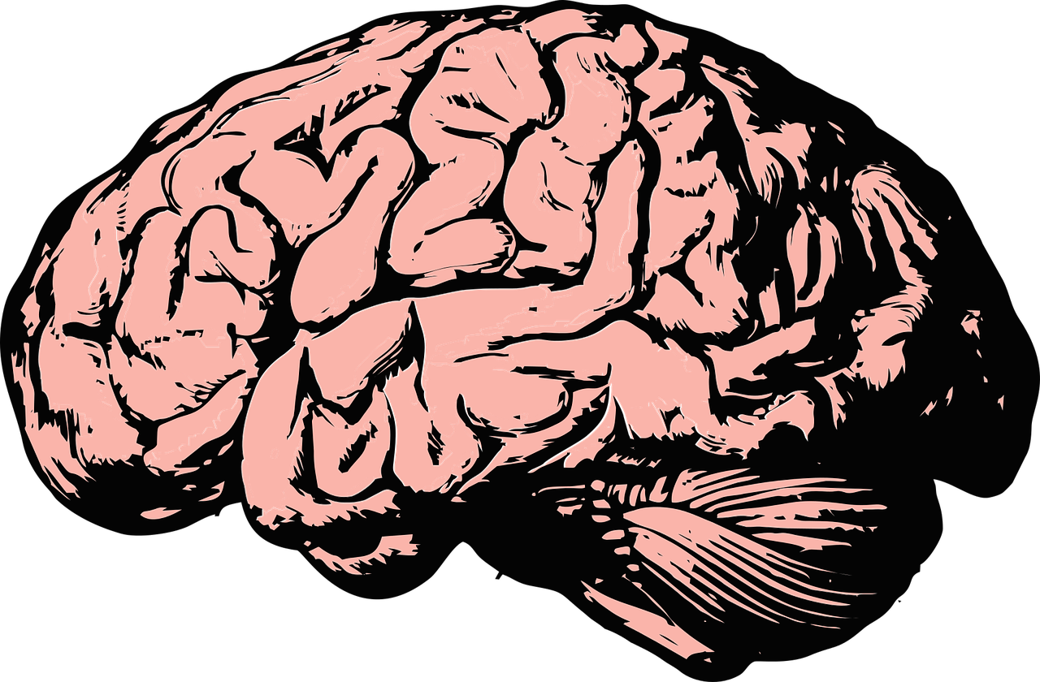
Inspiration behind Neural Networks
You brain
Hence "Neural"

Slide 7
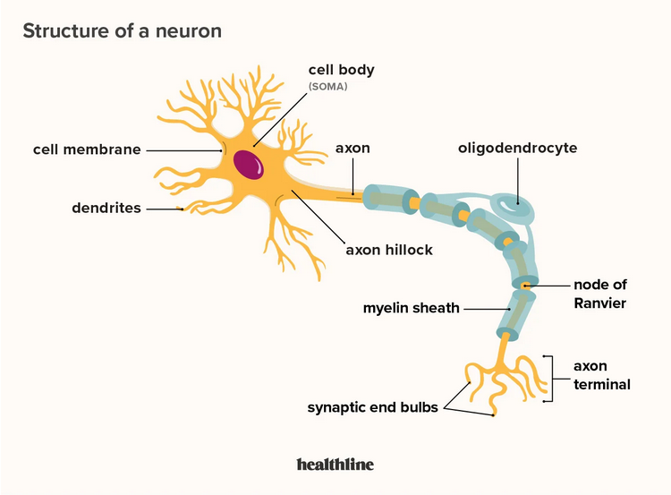
Neuron
https://www.healthline.com/health/neurons

Slide 8
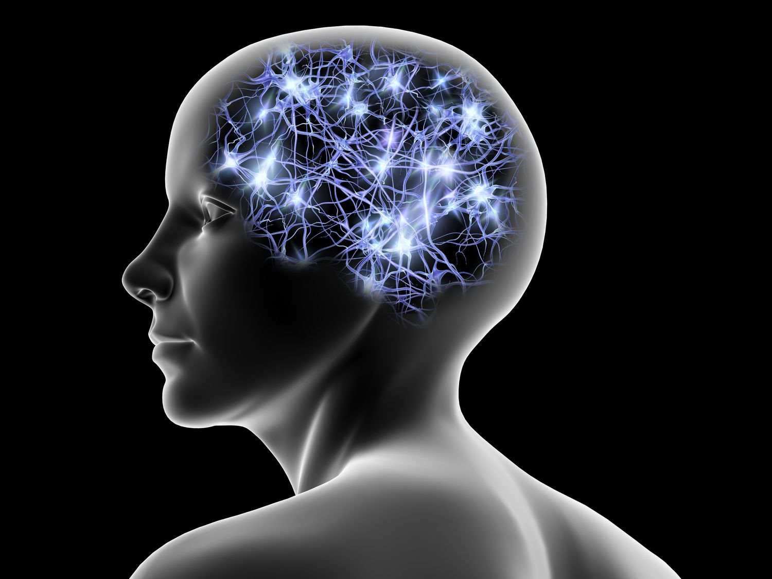
Neuron
Neuron sends messages to other neurons
Activate different parts of your nervous system
Your neural network is really responsible for you, how you think, how you move
Your neural network is concentrated in your brain, but is not completely limited to your brain
Spinal cord and nervous system as well
Not all of your cognition takes places in your brain
In octopuses, a lot takes places in their arms
https://www.lifewire.com/what-is-a-neural-network-5181580

Slide 9
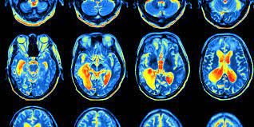
Your neural network
We know a fair amount about electrical activity in your brain
Fancy pictures
One zillion studies that talk about how something "lights up your brain"
Electrical activity related to the firing of different places in your neural network, different groups of neurons
Your brain is "plastic", neurons can change and die, and the connections between them can change over time
Studies suggest that the basic connections in your neural network are set in place pretty close to from birth
But the strength of the connections between them changes all throughout your life
https://www.eitrainingcompany.com/2017/05/reality-testing-and-learning-to-change-our-opinions/

Slide 10
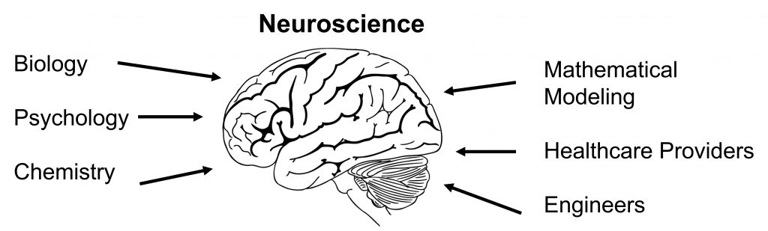
Neuroscience
Disclaimer: I am not a neuroscientist and most of my information is coming from research based on the AI-neuroscience connection
Neuroscience tries to study the ways we are wired and create understanding based on the wiring and firing of neurons
There are a lot of interesting things we can observe, and make conjectures based on observations
But a lot we just don't know much about
No definitive answer on why you dream
What causes your own inner monologue
https://openbooks.lib.msu.edu/introneuroscience1/chapter/what-is-neuroscience/

Slide 11
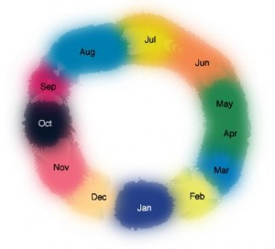
Neuroscience
But there are plenty of interesting observations we’ve made through neuroscience
Your neural network is highly interconnected
But also modular for tasks
We hypothesize the way it's wired can be responsible for different things:
Mental disorders: Too connected within units, not connected enough between them
Synesthesia: overconnected between sensory units
https://www.synesthesiatest.org/symptoms-of-synesthesia

Slide 12
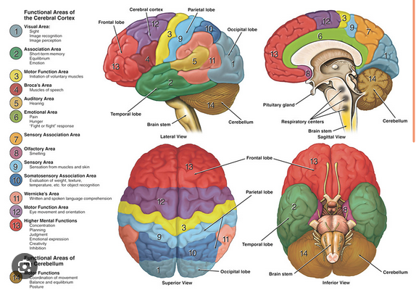
Architectures
Your brain has an interesting one
Your sensory integration is very interesting (vision, smell, etc)
https://dana.org/resources/neuroanatomy-the-basics/

Slide 13
Why Spend So Much Time Talking About Brains?
Because: neural networks model the hypothesized underlying biological principle

Slide 14
Why Spend So Much Time Talking About Brains?
Because: neural networks model the hypothesized underlying biological principle
Because: the model is highly imperfect (computer science is probably not very accurate to biology, and biology is more of a best-guess situation)

Slide 15
Why Spend So Much Time Talking About Brains?
Because: neural networks model the hypothesized underlying biological principle
Because: the model is highly imperfect (computer science is probably not very accurate to biology, and biology is more of a best-guess situation)
Because: We can use what we learn in both fields to help each other

Slide 16
Why Spend So Much Time Talking About Brains?
Because: neural networks model the hypothesized underlying biological principle
Because: the model is highly imperfect (computer science is probably not very accurate to biology, and biology is more of a best-guess situation)
Because: We can use what we learn in both fields to help each other
Because: AI comes with lots of ethical concerns and sooner or later you might have to weigh in on the AGI debate

Slide 17
Why Spend So Much Time Talking About Brains?
Because: neural networks model the hypothesized underlying biological principle
Because: the model is highly imperfect (computer science is probably not very accurate to biology, and biology is more of a best-guess situation)
Because: We can use what we learn in both fields to help each other
Because: AI comes with lots of ethical concerns and sooner or later you might have to weigh in on the AGI debate
Because: You are embodied, and AI available today is mostly not

Slide 18
Why Spend So Much Time Talking About Brains?
Because: neural networks model the hypothesized underlying biological principle
Because: the model is highly imperfect (computer science is probably not very accurate to biology, and biology is more of a best-guess situation)
Because: We can use what we learn in both fields to help each other
Because: AI comes with lots of ethical concerns and sooner or later you might have to weigh in on the AGI debate
Because: You are embodied, and AI available today is mostly not
Because: You are doing everything you're doing with less power than it takes to power a lightbulb

Slide 19

Brief Pause to Appreciate Your Brain
Low power, highly efficient
You can turn milkshakes into fast and accurate object detection
Your wiring is 100% unique to you

Slide 20
Ok
Let's talk about looking at this in a model

Slide 21
Base Unit of a Neural Network
Neuron

Slide 22
Neuron
Internal Parameters

Slide 23
Neuron
Internal Parameters
Input

Slide 24
Neuron
Internal Parameters
Input
Transformation Process

Slide 25
Neuron
Internal Parameters
Input
Output
Transformation Process

Slide 26
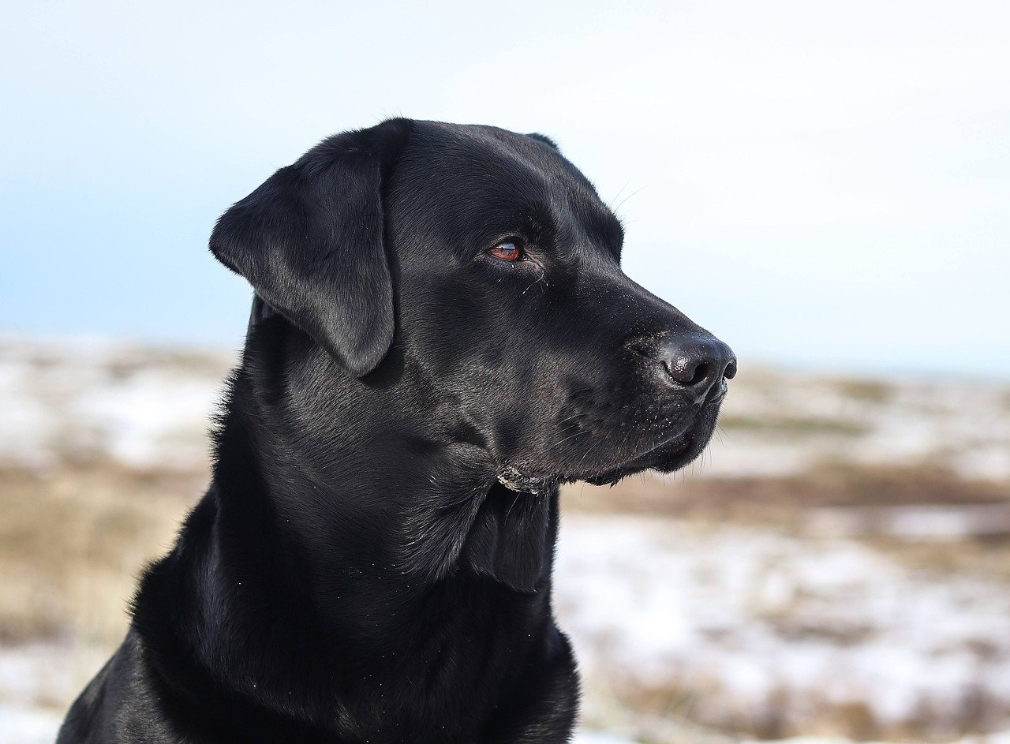
Multi Layer Perceptron
In this lecture we are going be going over a basic, but common neural network
If neural networks were dogs this one would be the labrador
Every so often for some reason it seems like they come up with another way to name this one
Multi-Layer Perceptron
Base Feed Forward Neural Network
Fully Connected Neural Network
Etc

Slide 27
Neural Networks
How are they structured?
How do they get their input?
How do they apply the transformation process?
Where does the output go?
What are the neurons internal parameters?
How do we evaluate a neural network?
How do we make it work well?

Slide 28
Structure of a Neural Network
Neurons are base unit
Neurons are arranged in layers
Layers as an organizing principle have to do with how the networks handles input/output
Layers can have any number of neurons
A neural network can have any number of layers
Layers, in general, receive the same input. Their output goes to the same layer.
Not all layers have to have the same number of neurons

Slide 29
Neuron

Slide 30
Neuron
Neuron
Neuron
Layer of 3 neurons

Slide 31
Neuron
Neuron
Neuron
Neuron
Neuron
Layer of 2 neurons
Layer of 3 neurons

Slide 32
Neuron
Neuron
Neuron
Neuron
Neuron
Neuron
Neuron
Layer of 2 neurons
Layer of 2 neurons
Layer of 3 neurons

Slide 33
3 Layer Neural Network
Neuron
Neuron
Neuron
Neuron
Neuron
Neuron
Neuron
Layer of 2 neurons
Layer of 2 neurons
Layer of 3 neurons

Slide 34
How do inputs and outputs work?
In a fully connected neural network, each layer gets input from the layer before it, and outputs to the next layer
The first layer gets input from your actual data
The last layer output is the overall network output or model prediction
Each neuron in a layer is connected to every other neuron in the layer before and every other neuron in the layer after,

Slide 35
Neural Networks
How are they structured? - DONE
How do they get their input?
How do they apply the transformation process?
Where does the output go?
What are the neurons internal parameters?
How do we evaluate a neural network?
How do we make it work well?

Slide 36
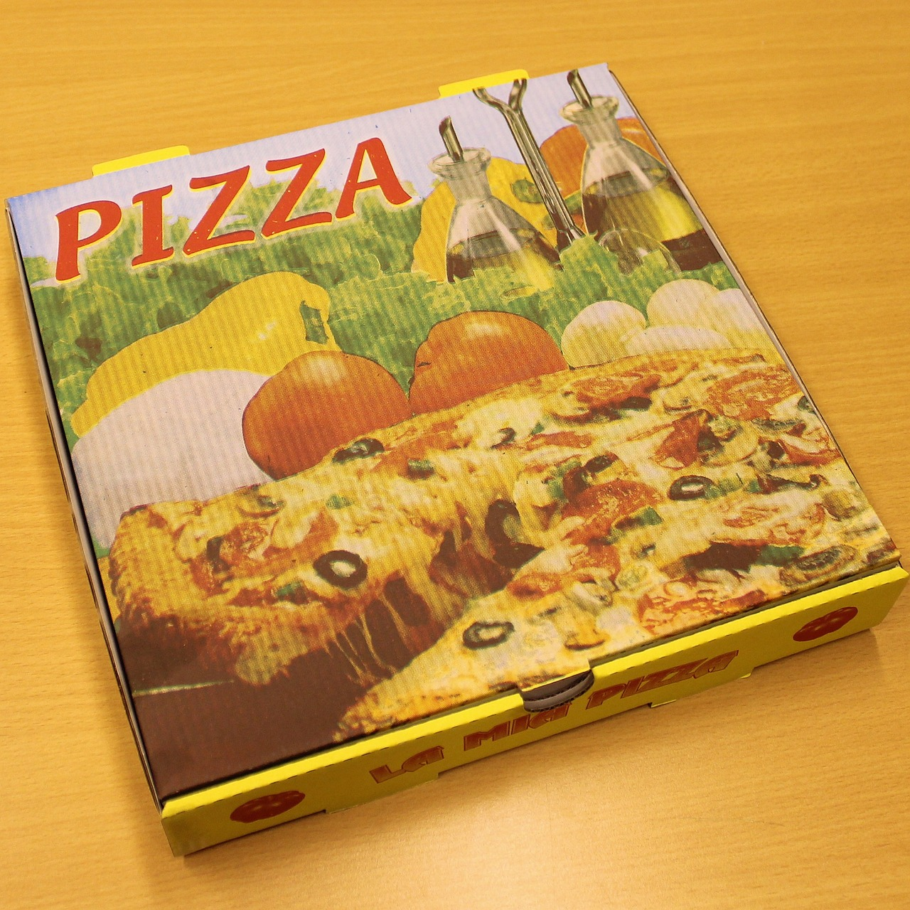
Easier to think about with an example
Pretend we are running a pizza delivery service
We are not allowed to open the pizza box
But we are naturally curious delivery people
We want to predict the type of pizza: pepperoni or cheese
And we have two variables: box weight and greasy percentage

Slide 37
Pizza Example
Two inputs:
Box weight
Greasiness %
One output with two possible values:
Cheese
Pepperoni
So, we want to construct a neural network to make this prediction based on the data we collected
Let's start with the first layer

Slide 38
Input
Layer 1
Box Weight
Greasiness %
Layer of 2 neurons

Slide 39
Input
Layer 1
Box Weight
I'm going to name this neuron Frank
Greasiness %
This neuron is named Helen
Layer of 2 neurons

Slide 40
Input
Layer 1
Box Weight
Frank
Greasiness %
Helen
Layer of 2 neurons
How do Frank and Helen get input?

Slide 41
Input
Layer 1
Frank and Helen both get both inputs
Frank gets to have the box weight and greasiness percentage
Helen gets to have the box weight and greasiness percentage
Box Weight
Frank
Greasiness %
Helen
Layer of 2 neurons

Slide 42
Input
Layer 1
Frank and Helen have different internal parameters
Based on their different internal parameters, they use the same input to generate different output
We will talk about the transformation they use to generate their output later
Box Weight
Frank
Greasiness %
Helen
Layer of 2 neurons

Slide 43
Input
Layer 1
Frank and Helen have different internal parameters
Based on their different internal parameters, they use the same input to generate different output
We will talk about the transformation they use to generate their output later
Box Weight
Frank
Frank's info
Greasiness %
Helen
Helen's info
Layer of 2 neurons

Slide 44
Input
Layer 1
Box Weight
Frank
Frank's info
Now what happens?
Greasiness %
Helen
Helen's info
Layer of 2 neurons

Slide 45
Input
Layer 1
Box Weight
Frank
Frank's info
Well, if we want, we can add another layer. Let's add a three neuron layer.
Greasiness %
Helen
Helen's info
Layer of 2 neurons

Slide 46
Input
Layer 1
Box Weight
Frank
Frank's info
Greasiness %
Helen
Helen's info
Layer of 2 neurons
Layer of 3 neurons

Slide 47
Input
Layer 1
This is Betty
Box Weight
Frank
Frank's info
This is Clint
Greasiness %
Helen
Helen's info
This is Emeril
Layer of 2 neurons
Layer of 3 neurons

Slide 48
Input
Layer 1
Betty
What do Betty, Clint, and Emeril get as input?
Box Weight
Frank
Frank's info
Clint
Greasiness %
Helen
Helen's info
Emeril
Layer of 2 neurons
Layer of 3 neurons

Slide 49
Input
Layer 1
What do Betty, Clint, and Emeril get as input?
The layer before them is Frank and Helen
Betty
Box Weight
Frank
Frank's info
Clint
Greasiness %
Helen
Helen's info
Emeril
Layer of 2 neurons
Layer of 3 neurons

Slide 50
Input
Layer 1
What do Betty, Clint, and Emeril get as input?
The layer before them is Frank and Helen
So they will get Frank and Helen's info (that layer's output) as input to their own layer
Betty
Box Weight
Frank
Frank's info
Clint
Greasiness %
Helen
Helen's info
Emeril
Layer of 2 neurons
Layer of 3 neurons

Slide 51
Input
Layer 1
Now that we have two layers, let's name the layers too so we can keep track of them
Frank and Helen are the master chef layer
Betty, Clint, and Emeril are the cardboard experts
Betty
Box Weight
Frank
Frank's info
Clint
Greasiness %
Helen
Helen's info
Emeril
Layer of 2 neurons
Layer of 3 neurons

Slide 52
Input
Layer 1
Now that we have two layers, let's name the layers too so we can keep track of them
Frank and Helen are the master chef layer
Betty, Clint, and Emeril are the cardboard experts
Betty
Box Weight
Frank
Frank's info
Clint
Greasiness %
Helen
Helen's info
Emeril
Master Chef Layer
Cardboard Experts

Slide 53
Layer 2
Input
Layer 1
The Master Chefs (Frank and Helen) get the raw input data
The Cardboard experts only get input from the Masters Chefs
But they all get the same information
Betty
Box Weight
Frank
Frank's info
Clint
Greasiness %
Helen
Helen's info
Emeril
Master Chef Layer
Cardboard Experts

Slide 54
Layer 2
Input
Layer 1
Betty gets Frank's info and Helen's info
Clint gets Frank's info and Helen's info
Emeril gets Franks's info and Helen's info
Betty
Box Weight
Frank
Frank's info
Clint
Greasiness %
Helen
Helen's info
Emeril
Master Chef Layer
Cardboard Experts

Slide 55
Layer 2
Input
Layer 1
Betty, Frank, and Emeril are getting the same input but are using their different internal parameters to generate different outputs
They are using an internal transformation to generate this info we will talk about later
Betty
Box Weight
Frank
Frank's info
Clint
Greasiness %
Helen
Helen's info
Emeril
Master Chef Layer
Cardboard Experts

Slide 56
Layer 2
Input
Layer 1
Betty
Betty's info
Box Weight
Frank
Frank's info
Clint
Clint's info
Greasiness %
Helen
Helen's info
Emeril
Emeril's info
Master Chef Layer
Cardboard Experts

Slide 57
Layer 2
Input
Layer 1
Betty
Betty's info
Box Weight
Frank
Frank's info
Clint
Clint's info
Greasiness %
Helen
Helen's info
Emeril
Emeril's info
Master Chef Layer
Cardboard Experts
Now what?

Slide 58
Layer 2
Layer 1
Betty
Betty's info
Input
Box Weight
Frank
Frank's info
Clint
Clint's info
Greasiness %
Helen
Helen's info
Emeril
Emeril's info
You decide you have enough neurons weighing in. You are going to add an output neuron.
Master Chef Layer
Cardboard Experts

Slide 59
Layer 2
I named him Dave
Layer 1
Betty
Betty's info
Input
Box Weight
Frank
Frank's info
Clint
Clint's info
Dave
Greasiness %
Helen
Helen's info
Emeril
Emeril's info
Deliveryman
Dave is a one-neuron layer who is going to decide if the pizza is pepperoni and cheese. He is an output layer. We’ll name is layer deliveryman
Master Chef Layer
Cardboard Experts

Slide 60
Layer 2
Layer 3
(Output)
Layer 1
Betty
Betty's info
Input
Box Weight
Frank
Frank's info
Clint
Clint's info
Dave
Greasiness %
Helen
Helen's info
Emeril
Emeril's info
Deliveryman
Dave is a layer ahead of the Cardboard Experts layer. His input is from Betty, Clint, and Emeril (their output)
Master Chef Layer
Cardboard Experts

Slide 61
Layer 2
Layer 3
(Output)
Layer 1
Betty
Betty's info
Input
Cheese
Or
Pepperoni
Box Weight
Frank
Frank's info
Clint
Clint's info
Dave
Greasiness %
Helen
Helen's info
Emeril
Emeril's info
Deliveryman
Dave uses his input and his internal parameters to generate an output. His output is whether the cheese is pizza or pepperoni. He gives us what we wanted to predict.
Master Chef Layer
Cardboard Experts

Slide 62
Let's go through an example
(Just on connectedness - we'll get to the transformation in a second)
You have a pizza come through
It's weight is 1 pound
It's greasiness % is 20.

Slide 63
Layer 2
Layer 3
(Output)
Layer 1
Betty
Betty's info
Input
Cheese
Or
Pepperoni
Box
Weight: 1
Frank
Frank's info
Clint
Clint's info
Dave
Greasiness
%: 20
Helen
Helen's info
Emeril
Emeril's info
Deliveryman
Master Chef Layer
First, Frank and Helen are both given the box weight number (1) and the greasiness % (20)
Cardboard Experts

Slide 64
Layer 2
Layer 3
(Output)
Layer 1
Betty
Betty's info
Input
Cheese
Or
Pepperoni
45
Box
Weight: 1
Frank
Frank's info
Clint
Clint's info
Dave
Greasiness
%: 20
27
Helen
Helen's info
Emeril
Emeril's info
Deliveryman
Master Chef Layer
Next, Frank and Helen use their expertise to generate new information. Frank comes up with the number 45 and Helen comes up with the number 27
Cardboard Experts

Slide 65
Layer 2
Layer 3
(Output)
101
Layer 1
Betty
Betty's info
Input
Cheese
Or
Pepperoni
45
Box
Weight: 1
Frank's info
0.3
Frank
Clint
Clint's info
Dave
Greasiness
%: 20
27
Helen
Helen's info
16
Emeril
Emeril's info
Deliveryman
Now, Betty gets the number 45 from Frank and the number 27 from Helen. She uses her own expertise to get the number 101.
Clint and Emeril use the same input to get the number 0.3 and 16.
Master Chef Layer
Cardboard Experts

Slide 66
Layer 2
Layer 3
(Output)
101
Layer 1
Betty
Betty's info
Input
Cheese
Or
Pepperoni
45
Box
Weight: 1
Frank's info
0.3
Frank
Clint
Clint's info
Dave
Greasiness
%: 20
27
Helen
Helen's info
16
Emeril
Emeril's info
Deliveryman
Master Chef Layer
Finally, Dave gets 101 from Betty, 0.3 from Clint, and 16 from Emeril. He uses this information to decide that it's a cheese pizza.
Cardboard Experts

Slide 67
Important Information
It's called a feed forward network, because the information goes forward layer by layer until you get an output
It's a big ol' game of extremely additive telephone
Each layer only gets the layer's information before it
Only Frank and Helen see the raw data. They try to extract useful information from it
Betty, Clint, and Emeril only get to see Frank and Helen's information. They have to use what they know about Frank and Helen and their own expertise to generate their information
Dave only gets to see the information from Betty, Clint, and Emeril. He tried to use what he knows about these three as well as his own expertise to guess if it's cheese or pepperoni.

Slide 68
Important Information
We hope layers extract useful features. These are value-added information from the raw data
We hope each layer learns how to use the information it's given to extract more and more useful information
Eventually leading to a very useful prediction
We sort of assume each neuron has its own area of expertise, like it's focusing on one specific concept. What information its actually generating can get extremely abstract.

Slide 69
Neural Networks
How are they structured? - DONE
How do they get their input? - DONE
How do they apply the transformation process?
Where does the output go?
What are the neurons internal parameters?
How do we evaluate a neural network?
How do we make it work well?

Slide 70
How does the Neuron Create New Information from the Inputs?
Transformation Process
Theoretically, a neural network can model any underlying function with enough nodes and layers
But in order to do that, we need to allow the neural network to have components that are non-linear (activation function)
Neuron has the following internal parameters:
Weights
Bias
Activation function
The weights and bias for a given neuron should be specific to that particular neuron.
The activation function isn't a value, it's a process. So the same activation function proces might be used for the same neurons in a layer or even across layers.
But the output of the neuron is based on the inputs, weights, and bias in combination put through the activation function
So output of neuron should be specific to that particular neuron.

Slide 71
Example
Let's look at Frank

Slide 72
Frank
Internal Parameters
Input
Output
Transformation Process

Slide 73
Pizza Box Weight
Greasiness %
Frank gets 2 inputs: Pizza Box weight and Greasiness %

Slide 74
Pizza Box Weight
Greasiness %
Frank has several internal parameters. One of these is weights.

Slide 75
c
Pizza Box Weight Weight
c
Pizza Box Weight
Weights
Greasiness % Weight
c
Greasiness %
Frank has same number of weights as inputs. In fact, each weight is assigned to a particular input

Slide 76
c
Pizza Box Weight Weight
c
Pizza Box Weight
Weights
Greasiness % Weight
c
Greasiness %
Frank's Bias
c
c
Bias
c
Frank also has an internal parameter called a bias. Frank only has one bias term.

Slide 77
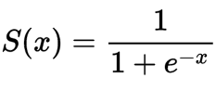
https://en.wikipedia.org/wiki/Sigmoid_function
c
Pizza Box Weight Weight
c
Pizza Box Weight
Weights
Greasiness % Weight
c
Greasiness %
Frank's Bias
c
c
Bias
c
Frank uses an activation function called sigmoid: It's a process, not a value. He feeds this process a value and it gives him a different value.

Slide 78
https://en.wikipedia.org/wiki/Sigmoid_function
c
Pizza Box Weight Weight
c
Pizza Box Weight
Weights
Greasiness % Weight
c
Greasiness %
Frank's Bias
c
c
Bias
c
Frank now has everything he needs to make an output value (generate new information). He does this in a few steps.

Slide 79
https://en.wikipedia.org/wiki/Sigmoid_function
Pizza Box Weight Weight*Pizza Box Weight
Pizza Box Weight Weight
Pizza Box Weight
Greasiness % Weight
Greasiness % Weight * Greasiness Percent
Greasiness %
Frank's Bias
Frank multiples the weights by the inputs.

Slide 80
https://en.wikipedia.org/wiki/Sigmoid_function
Pizza Box Weight Weight*Pizza Box Weight
Pizza Box Weight Weight
Pizza Box Weight
Greasiness % Weight
Greasiness % Weight * Greasiness Percent
Greasiness %
Frank's Bias
2. Frank adds these numbers together.

Slide 81
https://en.wikipedia.org/wiki/Sigmoid_function
Pizza Box Weight Weight*Pizza Box Weight
Pizza Box Weight Weight
Pizza Box Weight
Greasiness % Weight
Greasiness % Weight * Greasiness Percent
Greasiness %
Frank's Bias
3. Frank adds the bias term
Frank's Bias

Slide 82
https://en.wikipedia.org/wiki/Sigmoid_function
Pizza Box Weight Weight
Pizza Box Weight
Activation
Greasiness % Weight
Greasiness %
Frank's Bias
4. This number creates Frank's weighted sum, or activation, term. It's a linear combination of inputs. To make a non-linear output, he must use the activation function.

Slide 83
https://en.wikipedia.org/wiki/Sigmoid_function
Pizza Box Weight Weight
Pizza Box Weight
Activation
Greasiness % Weight
Greasiness %
Output
Frank's Bias
4. Frank puts his weighted sum or activation though the activation function process. This spits out his output. This is Franks information.

Slide 84
Example
Pizza Box weight is 1
Greasiness % is 10
Frank's Pizza box weight weight is 2
Frank's greasiness % weight is 5
Frank's bias term is 6
Frank's activation function process of choice is Sigmoid

Slide 85
Example
Pizza Box weight is 1
Greasiness % is 10
Frank's Pizza box weight weight is 2
Frank's greasiness % weight is 5
Frank's bias term is 6
Frank's activation function process of choice is Sigmoid
Let's do weights*inputs first
Pizza box weight * pizza box weight weight
1*2 = 2
Greasiness % * greasiness % weight
10*5 = 50
Add these together
2+50 = 52

Slide 86
Example
Pizza Box weight is 1
Greasiness % is 10
Frank's Pizza box weight weight is 2
Frank's greasiness % weight is 5
Frank's bias term is 6
Frank's activation function process of choice is Sigmoid
Now let's add the bias term to that number
52 + 6 = 58
58 is our weighted sum
Or activation
Or dot product
Or a lot of other labels. Why, data scientists??!!

Slide 87
Example
Pizza Box weight is 1
Greasiness % is 10
Frank's Pizza box weight weight is 2
Frank's greasiness % weight is 5
Frank's bias term is 6
Frank's activation function process of choice is Sigmoid
Now we are going to put that number through the sigmoid function
Sigmoid(58) = 1
(sigmoid contrains output between 0 and 1. Sigmoid is not the only activation function choice. In implementation, not always popular, but popular for examples. We'll see why later).
So Frank's output is 1.

Slide 88
Neural Network
Each node carries out the same transformation, but with different weights and bias terms
Neurons in different layers have different inputs
Neurons in the same layer have the same input, however

Slide 89
Layer 2
Layer 3
(Output)
101
Layer 1
Betty
Betty's info
Input
Cheese
Or
Pepperoni
45
Box
Weight: 1
Frank's info
0.3
Frank
Clint
Clint's info
Dave
Greasiness
%: 20
27
Helen
Helen's info
16
Emeril
Emeril's info
Deliveryman
Master Chef Layer
Cardboard Experts

Slide 90
Error
The output of the network was not necessarily correct
You can calculate the error of a network guess with any applicable error function
Lots of options – similar to our tabular data
We can use MSE or something similar

Slide 91
Neural Network Hyperparameters

Slide 92
Hyperparameters are...

Slide 93
Hyperparameters are...
Parameters that the engineer sets
Generally, the model is not adjusting them during training

Slide 94
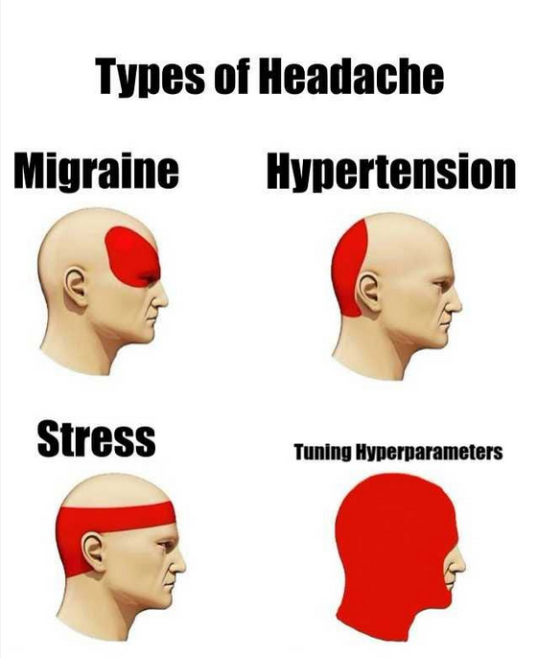
Neural Network Hyperparameters
There are a lot of them
Tuning them is often the majority of what you will be doing
https://medium.com/@dyllanjrusher00/dont-get-stuck-tuning-hyperparameters-c9d2b29f004d

Slide 95
Neural Network Hyperparameters
Number of layers
Number of nodes in each layer
Activation function selection
Regularization
Cost/Loss/Error function selection
Batch size per error backpropagation
Learning rate and/or optimizer
Number of epochs
Data Augmentation

Slide 96
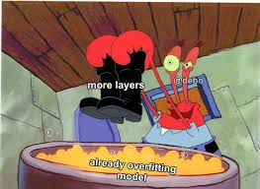
Number of layers
When we refer to neural network "deepness", we are usually referring to how many layers are in the network, rather than how many nodes per layer
Though deepness is more realistically a function of both
RULE OF THUMB (this is just typical! Not true in all cases!)
More layers = more capacity to learn
More layers = better for large amounts of data/high dimensional data
More layers = higher chance of overfitting
More layers = more training time
https://www.facebook.com/convolutionalmemes/posts/follow-us-on-instagramhttpswwwinstagramcomrealmlmemes-debojeet/1326047464516417/

Slide 97
Number of nodes in each layer
Hard to figure out how to set this
RULE OF THUMB: More nodes in a layer at beginning of network, less near end
Assuming we have sort of a feature pyramid
Start with "low level" features
Turn into progressively more informative features
End with usually same number of nodes as output classes

Slide 98
Example: Neural Network for Medicine Dispersal
Which, by the way, is probably a terrible idea
Input: patient biometrics
Body temperature
Heart Rate
Sinus Pressure
Blood Pressure
Skin appearance
Skin feeling
Tonsil size

Slide 99
Layer 1
We hope it finds symptoms:
Body temp > 101 = fever
Tonsil size abnormal AND sinus pressure= sore throat
Skin appearance is red AND skin feeling is itchy = rash

Slide 100
Layer 2
We hope maybe it makes a diagnosis distribution
Inputs: Rash, sore throat, fever
Output – strep throat 80% OR tonsillitus 50% OR common cold 10%

Slide 101
Output layer
Input: percent confidence of each disease
Output: medication is recommended (antibiotics)

Slide 102
Feature engineering
We don't know what's actually going on under the hood for a neural network
We are sort of assuming it's doing this automatically
It probably isn't
But kind of the assumption goes more low level info -> more higher level info -> output
Feature engineering can be done for lots of models including neural networks, but is less common than with other approaches

Slide 103
Activation Function
Sigmoid
Tanh
Relu
Leaky Relu
Softmax

Slide 104
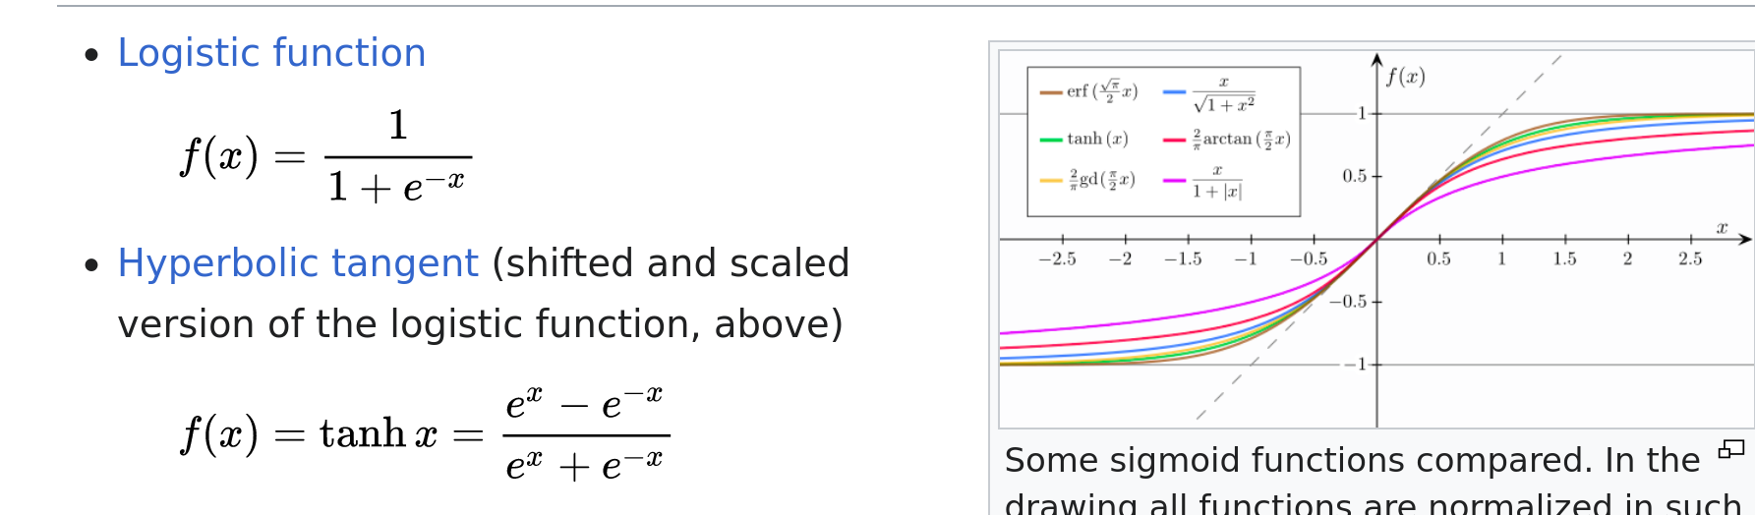
Sigmoid Function and Tanh
Quashes between 0 and 1 (sigmoid) -1 and 1 (tanh)
Saturates quickly
https://en.wikipedia.org/wiki/Sigmoid_function

Slide 105
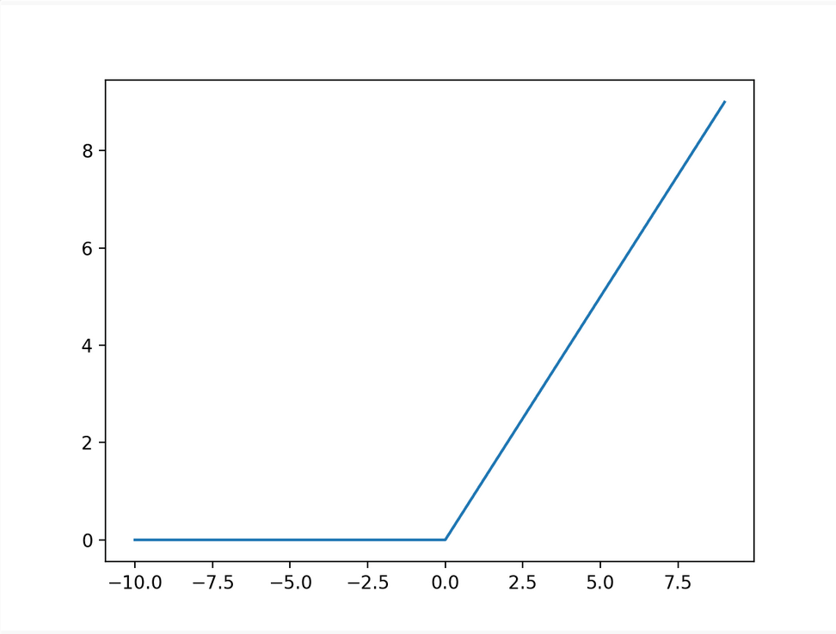
ReLU
Rectified Linear Unit
If input <= 0 = 0
Otherwise input = 0
Output is positive or 0
Very popular and often the default
https://machinelearningmastery.com/rectified-linear-activation-function-for-deep-learning-neural-networks/

Slide 106
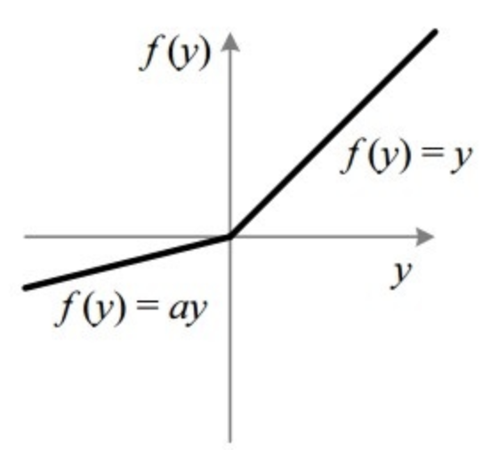
Leaky Relu
Allows some small negative numbers
https://paperswithcode.com/method/leaky-relu

Slide 107
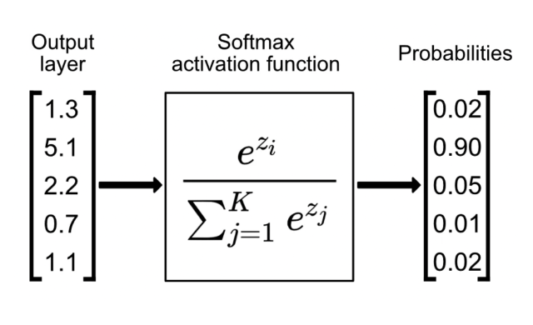
Softmax Function
Popular for one-hot encoded classification problems
Turns all outputs into probabilities that sum to 1
https://www.singlestore.com/blog/a-guide-to-softmax-activation-function/

Slide 108
Regularization
Exploding and Vanishing Gradients for Large Errors
Add a penalty term (often L1 or L2 norms) to error function
Has the effect of shrinking weights that don't contribute much
Dropout – randomly drop some connections during training (noisy)
Regularization quite often improves neural network performance
https://theaisummer.com/regularization/

Slide 109
Cost/Loss/Error Function Selection
MSE
MAE
RMSE
Cross Entropy

Slide 110
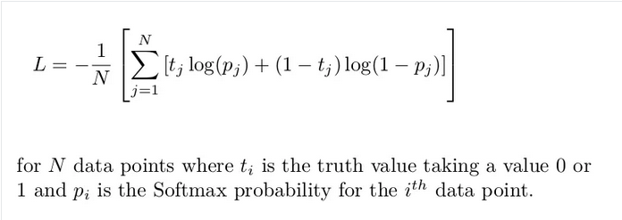
Cross Entropy Function
Looks at difference between two distributions
Also comes out of information theory
Also popular, especially with high dimensions
https://www.datacamp.com/tutorial/the-cross-entropy-loss-function-in-machine-learning

Slide 111
Batch Size
Batch gradient descent – how many examples do you want to average the error over?
Usually implement in powers of 2 (32, 64, 128, etc)
Larger batches -> less backprop -> more averaged -> usually faster
May lose some info, have a higher memory cost (run things in parallel)
Smaller batches -> more backprop -> takes longer to train

Slide 112
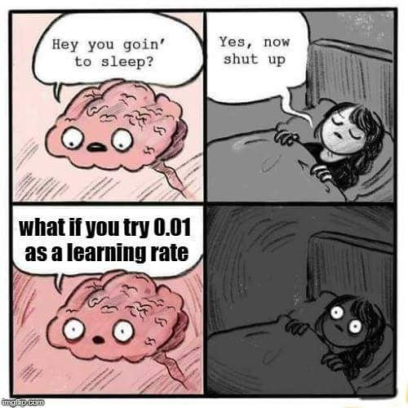
Learning Rate
Step size of weight/bias adjustment
Usually a very small number
Often adjust it by powers of 10 (1e-4, 1e-5, etc)
Tricky because
Want it to converge fast
But don't want to get stuck in a local minimum
https://x.com/mlinterview/status/993257627244204032

Slide 113
Optimizers
Adjust your learning rate based on the performance of the neural network
Momentum
RMSProp
Adam

Slide 114
Momentum
Incorporates information about the last weight update into the current weight update
Gain "momentum" by doing so
More robust to noise
https://medium.com/@vinodhb95/momentum-optimizer-6023aa445e18

Slide 115
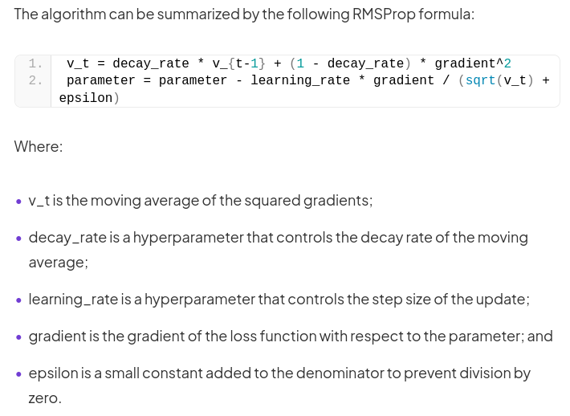
RMSProp
Moving average of gradients to control weight update
https://deepchecks.com/glossary/rmsprop/

Slide 116
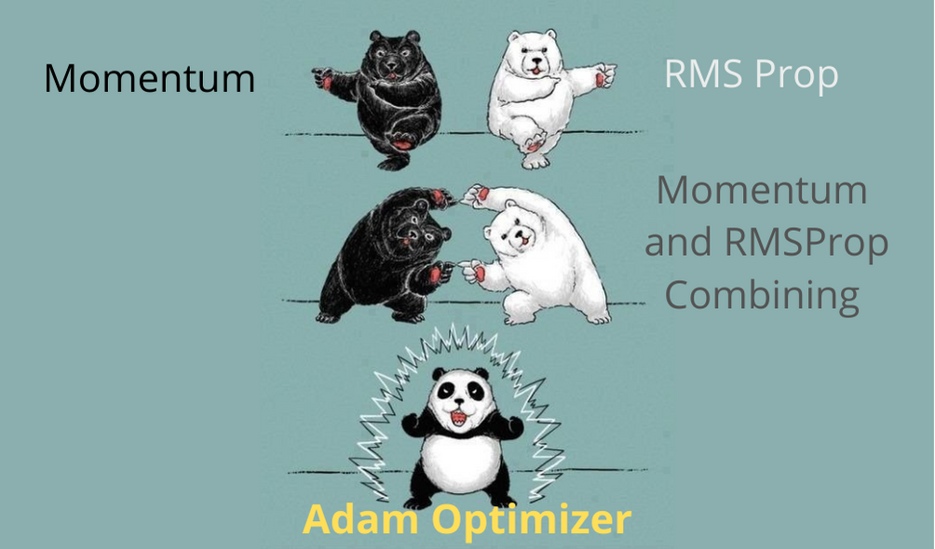
Adam
https://datamonje.com/gradient-descent-and-variants/

Slide 117
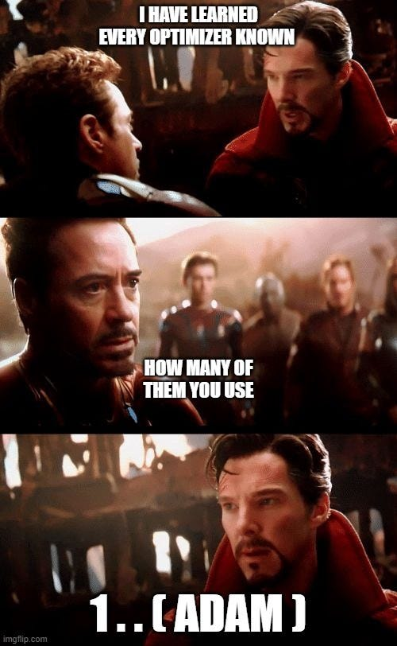
Adam
Hard to overstate the popularity of this one
Doesn't mean you have to use it
But it tends to do well, so everyone and their dog uses it
https://medium.com/analytics-vidhya/mechanism-of-gradient-descent-optimization-algorithms-7baed9c9c35e

Slide 118
Number of Epochs
How many times do you let your neural network train on the complete set of training data (different from number of batches)
Early stopping – using the validation set, most often
Usually set this rather than trying to get to a certain accuracy
Often a trial and error process

Slide 119
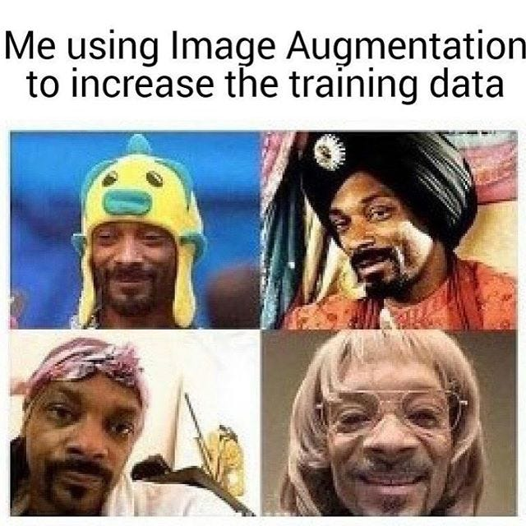
Data Augmentation
Taking your existing data
Changing it slightly so it's "new"
Suddently you have more data
Very often used for convolutional neural networks
https://medium.com/analytics-vidhya/data-augmentation-keras-in-nutshell-theory-98c2e865abce

Slide 120

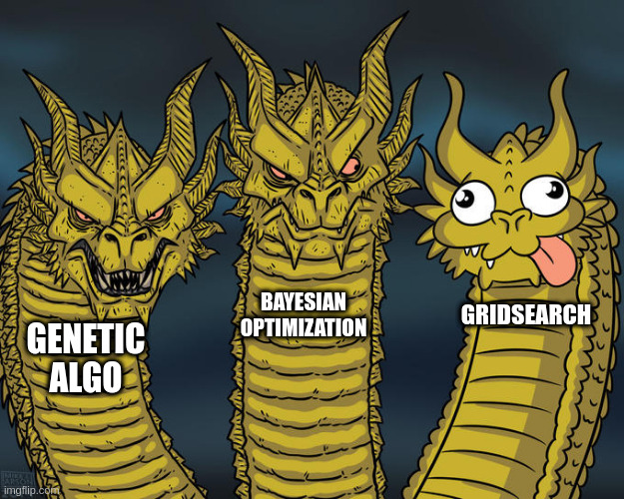
How to find the best hyperparameters
Guess what
This is not a solved problem
Trial and Error
Maybe Grid Search
Maybe NAS
https://clear.ml/blog/how-to-do-hyperparameter-optimization-better
https://clear.ml/blog/how-to-do-hyperparameter-optimization-better

Slide 121
If at first you don't succeed...
Then you will probably understand that machine learning is a LOT of trial and error

Slide 122
Training a Model in Keras

Slide 123
Keras Documentation
Layers API: https://keras.io/api/layers/
Input Layer: https://keras.io/api/layers/core_layers/input/
Dense Layer: https://keras.io/api/layers/core_layers/dense/
Model API: https://keras.io/api/models/model/#model-class
Model Training API: https://keras.io/api/models/model_training_apis/#fit-method
Losses: https://keras.io/api/losses/
Metrics: https://keras.io/api/metrics/
Callbacks: https://keras.io/api/callbacks/

